Slide 1


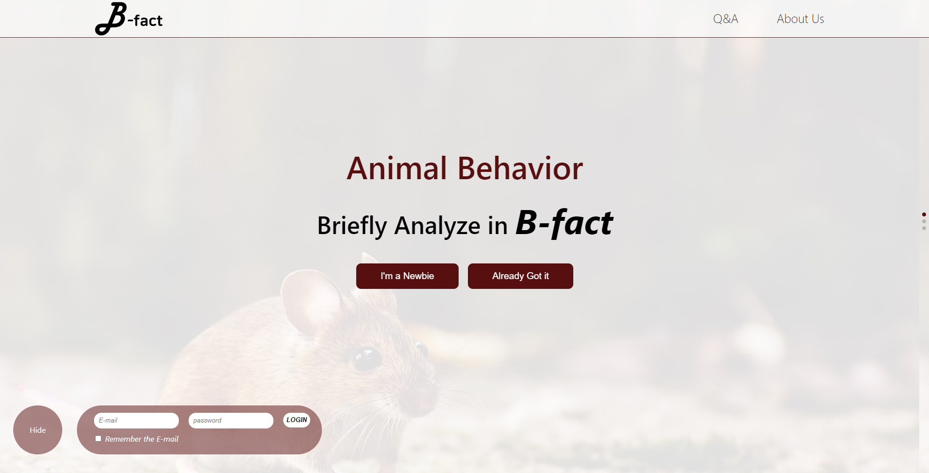








Title
AI 동물 행동 분석 프로젝트
박성준 20205075
권재용 20185016
Kohinur Akter 20201166
B-fact · 1

Slide 2
Chap
0
Index
목차
SW Development Plan
Problem·Marketability·Main Task·Prototype Model
2. Requirements
Analysis·Specification
5. Testing
Unit test
3. SW Design
UML·Pipeline·Architecture
6. Maintenance
VCS & Cooperation Tool
4. Implementation
Frontend·Backend·AI Model
B-fact · 2

Slide 3




Chap1
SW Development Plan
Problem
Hypothesis
In biomedical research area,
It requires “Animal Behavioral Analysis”
생의학 연구에서 종종 동물에 대해 행동 분석이 필요
However, usually encounter the problem
for lack information to use the data
그러나, 연구자 대부분은 데이터를 이용하기 위한 지식이 부족함
B-fact · 3

Slide 4
Chap1
SW Development Plan
Marketability
According to Sematic Scholar,
related research have been
an Increasing trend.
관련 연구 주제는 증가하고 있는 추세
B-fact · 4

Slide 5
Chap1
SW Development Plan
Main Task
Show the visualization graph
시각화된 그래프 생성
Provide analyzed .xlsx file
Make web to process
분석이 완료된 xlsx 파일 제공
접근을 위한 웹사이트 제작
Use of AI in animal behavioral mapping
B-fact · 5

Slide 6
Chap1
SW Development Plan
Prototype Model
Implementation
Initial Requirement
Design
Evaluation
Review & Update
Bio-lab wants various model to use
Need to update requirement frequently
Developers are far from topic
→ Check for accepting requirement
생의학 연구실은 다양한 모델이 필요하므로, 요구 사항을 자주 업데이트
Maintain
Test
Develop
일부 개발자는 주제에 친숙하지 않기에, 주기적으로 요구 사항 충족 확인
B-fact · 6

Slide 7
Chap1
SW Development Plan
Prototype Model
Implementation
Initial Requirement
Design
Evaluation
Review & Update
In customer evaluation,
we get feedback from the lab members.
고객 평가는 생의학 연구실에서 피드백을 얻었음
Maintain
Test
Develop
B-fact · 7

Slide 8


Chap2
Requirements
Analysis
User’
Systems’
Need introduction to use B-fact
Get result for excel and graph
Need register system to save result
Notice for the error message
Enter the options for model
Sufficient DB size
for save the videos
Pretrained Model for
Developing mapping it
B-fact · 8

Slide 9
Chap2
Requirements
Specification
Requirement ID | Name | Input | Content | Output | Priority
REQ_BSG_001 | Introduction | N/A | Provide a introduction to show how to use this services. Manual – Prepare Video, Upload, Get Result | N/A | Medium
REQ_BSG_002 | Upload | Video Mouse Name Experiment Model Heredity Genotype | User can upload their animal video. The page will contain four input options. A trained deep learning classifier will be deployed to classify the animal behavior detected on video frames. The classification model output will be trained with different animal (mouse) behavior videos to classify animal behavior. | Cutted Images | High
REQ_BSG_003 | Result | Repository source | The output will be shown from the animal behavior sequence data as a graphical representation of time/frame vs. behavior, and behavior vs. frequency/time duration of the behavior.(we can add the customization of the time or frame duration to analyze the required clip from the video) and the graph can be copied and download. If possible dynamic visual graph will be generated, otherwise static Graph. | .csv file, 3 type of graph | High
B-fact · 9

Slide 10
Chap2
Requirements
Specification
Requirement ID | Name | Input | Content | Output | Priority
REQ_BSG_004 | Register | E-mail Password Password Check | This page will collect all the information to create a registered unique ID. | Validity | Medium
REQ_BSG_005 | Login | E-mail Password Remember Option | Check the authenticity of the user with e-mail and password. There will be ”Remember Option”. | Validity | Medium
REQ_BSG_006 | Error | N/A | When loading a page with an unexpected error fails, it indicates an error. | Message | Low
REQ_BSG_007 | Classification Model | Video | The model will be used here consists custom layers of several convolutional layers, batch normalization and activation layer finally a flatten layer on the top of pre-trained resnet152 as an feature extractor. | Videos-by-frame | High
B-fact · 10

Slide 11
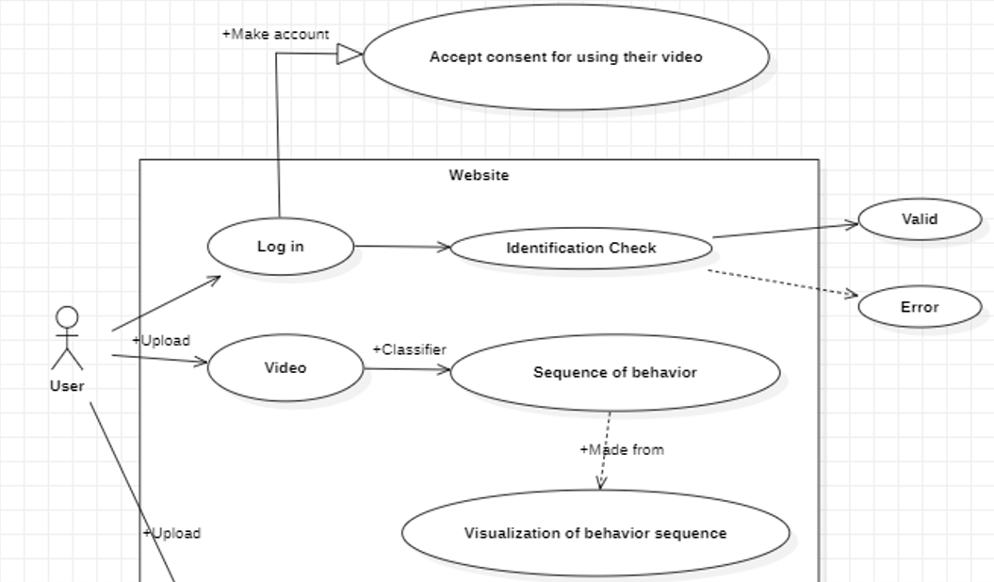
Chap3
SW Design
UML
Use-case model
1. Need to get authentication check
2. Registered user can be upload video
3. Can evaluate and then visualize the result
B-fact · 11

Slide 12
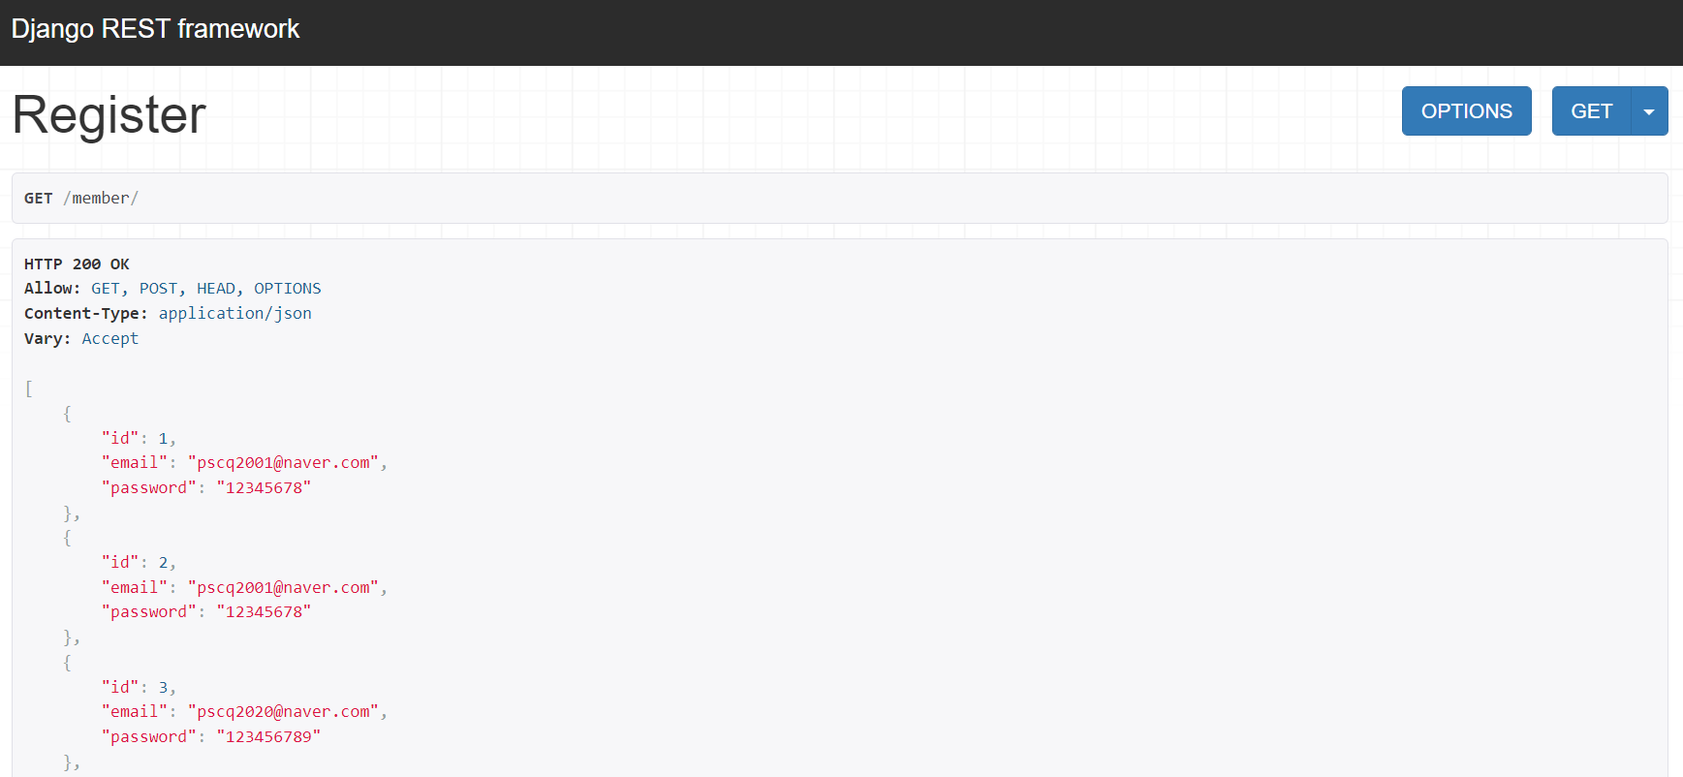

Chap3
SW Design
Pipeline
Front-end
Back-end
AI Model
React, Node.js
Django, Restframework
Pytorch
* View, Error Handle
* Manage DB, Function
* Construct Result
B-fact · 12

Slide 13

Chap3
SW Design
AI Model
AI
Architecture
Router
components
Service
REST Framework
Model
axios
router
Serializer
Database
React
Django
B-fact · 13

Slide 14
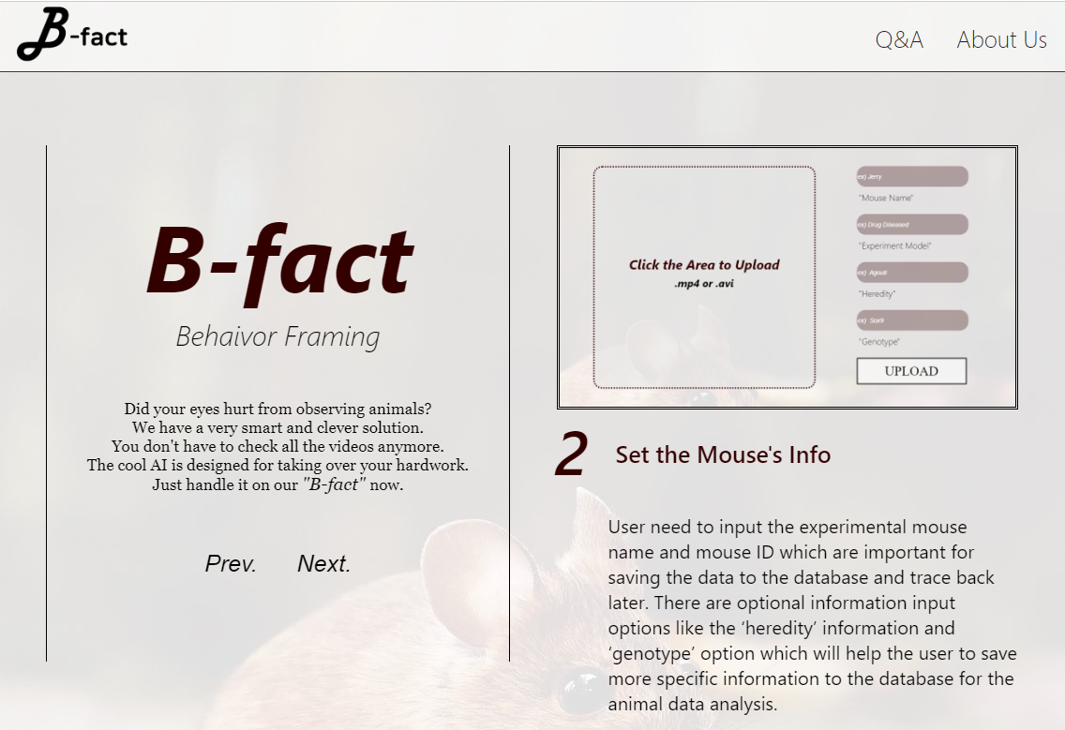
Chap3
SW Design
Architecture – Frontend
Django
Input tag
Button
View
POST
Error Handling
Axios
useState
EventHandle
GET
B-fact · 14

Slide 15
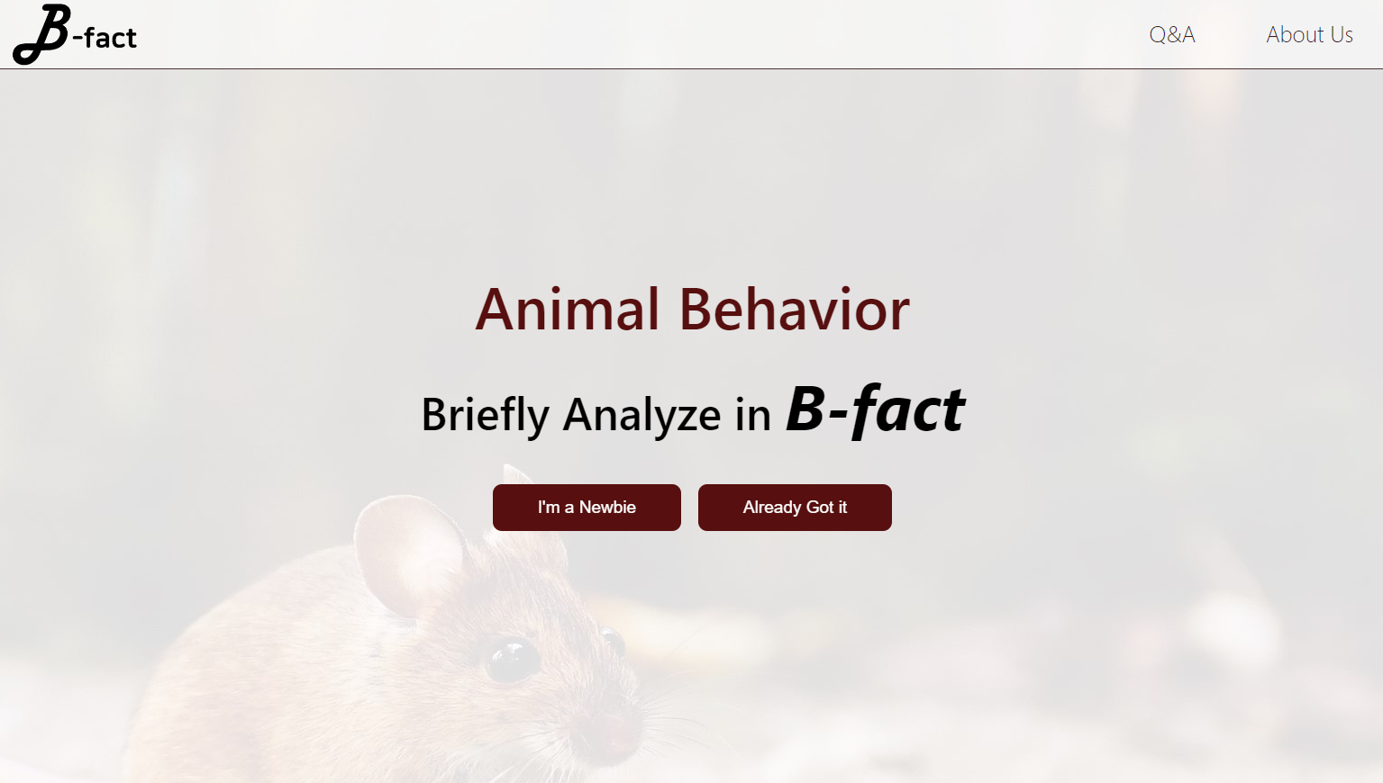
Chap4
Implementation
Front-end
Moving the Slide
Swipe the full-page by using scroll and keyboard
B-fact · 15

Slide 16
Chap4
Implementation
Front-end
Display: flex
Making const.
template rendering function
Button to handle the right-box content
B-fact · 16

Slide 17
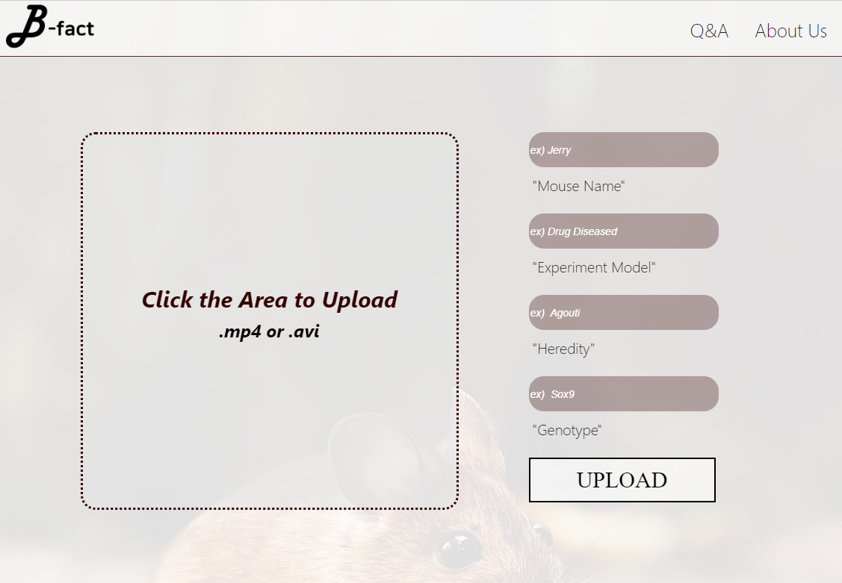
Chap4
Implementation
Front-end
Label div for hiding default upload theme.
Hover; to highlight to show reactive button
B-fact · 17

Slide 18
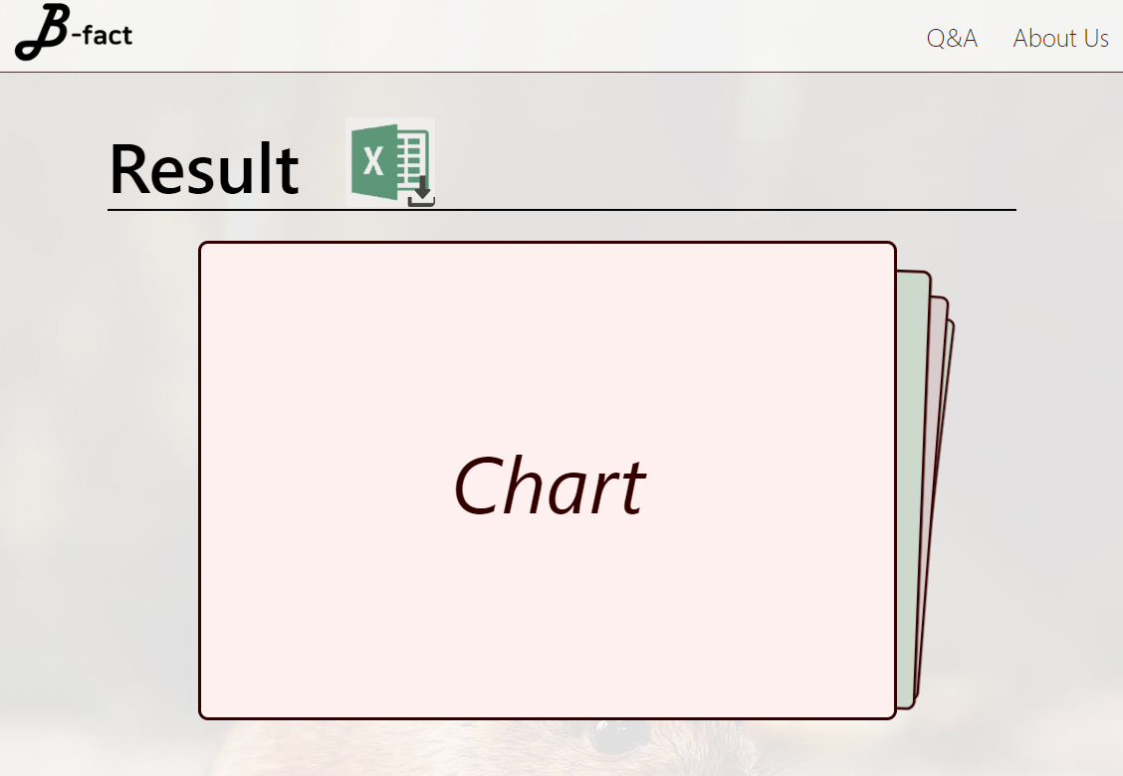
Chap4
Implementation
Front-end
Download <a> tags to get result
text-align: center
Swiper.js (Effect Cards)
To display charts
B-fact · 18

Slide 19

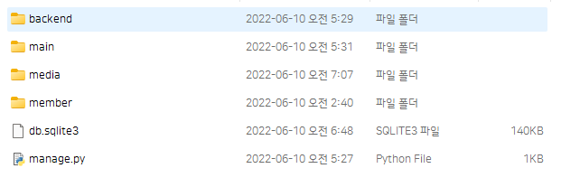

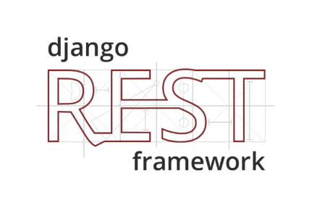
Chap3
SW Design
Architecture – Backend
AI
Django
Front-end
DB
B-fact · 19

Slide 20
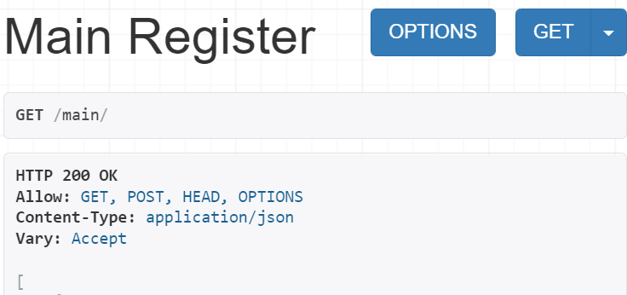
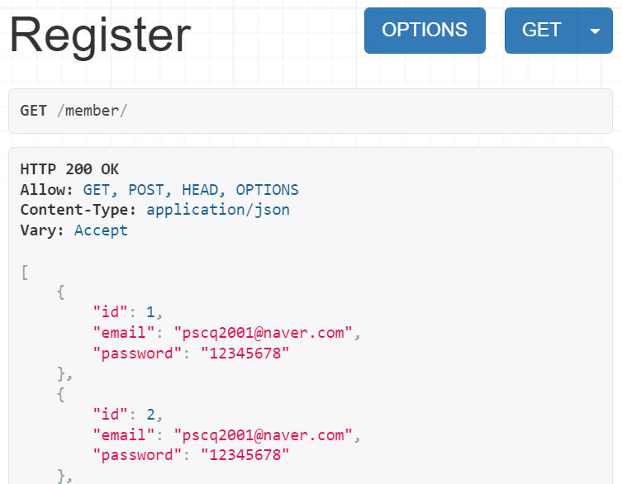
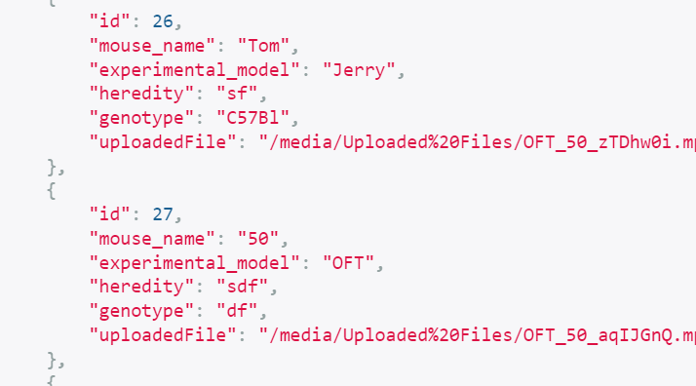
Chap4
Implementation
Back-end
Uploaded Video object
User objects
B-fact · 20

Slide 21
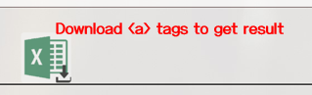
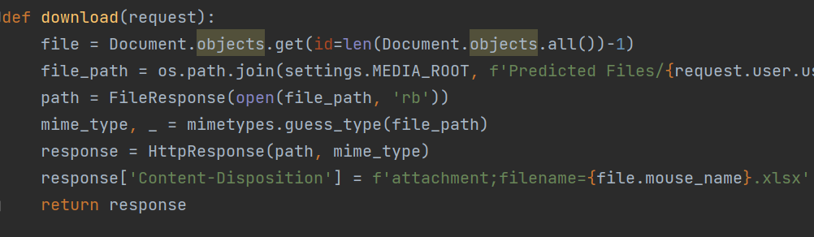

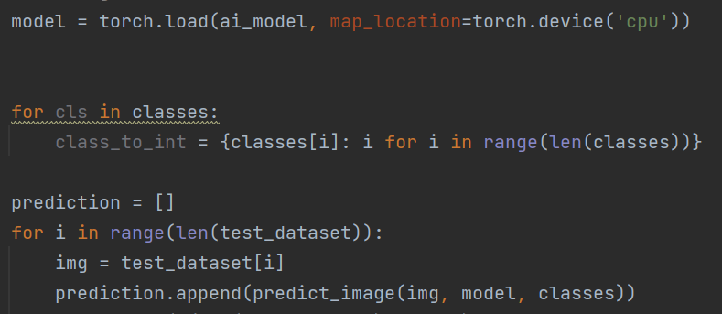
Chap4
Implementation
Back-end
Running AI model in backend part
Control flow of data
B-fact · 21

Slide 22
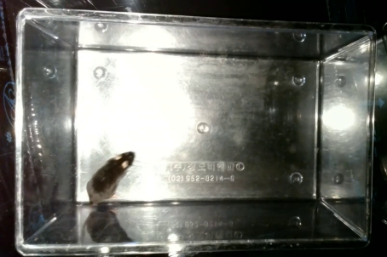
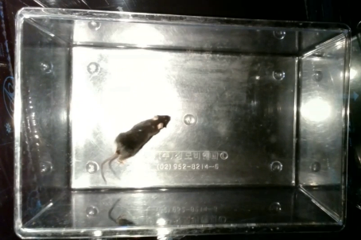
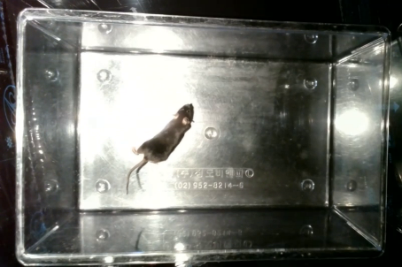
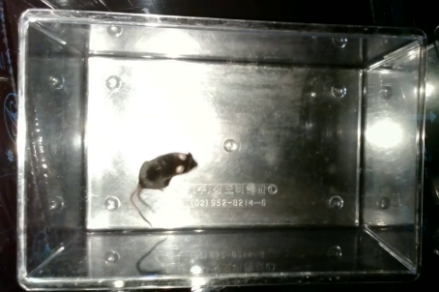
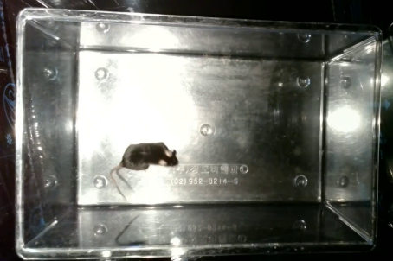
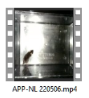
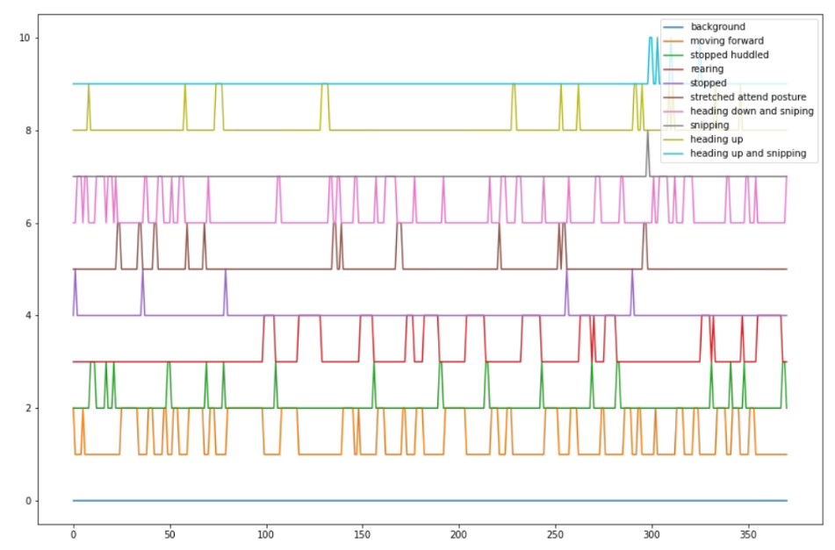
Chap3
SW Design
Architecture – AI
Resnet 152
Django
Video Cutting
Fin-tuned for
Image Classification
Behavior sequence prediction
[‘Moving forward’, ‘snipping’,…]
Visualization
B-fact · 22

Slide 23
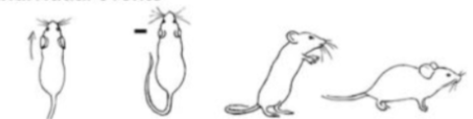
Chap4
Implementation
AI Model: Dataset & Fine-tuning
Dataset Generation
1 | Moving Forward
2 | Stopped
3 | Heading up
4 | Rearing
5 | Heading down
6 | Heading down and snipping
7 | Stopped and huddled
8 | Stretch attend posture
9 | Snipping
10 | Background
Online videos and lab
Frame extraction and manual labeling
Fine-tuning the model
Resnet 152 model is fin-tuned
1
2
3
4
B-fact · 23

Slide 24
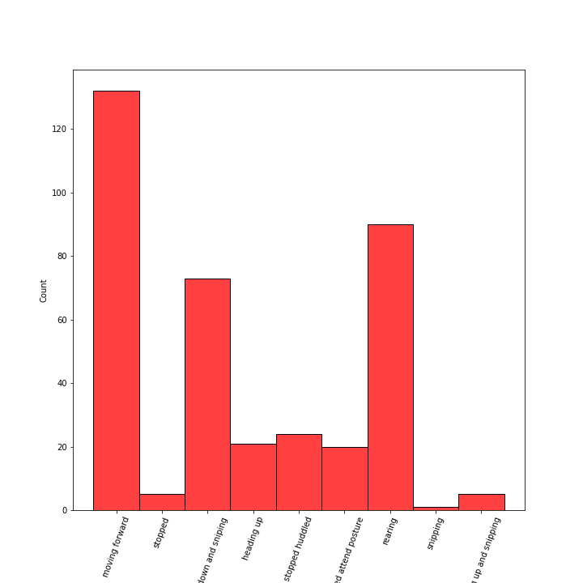
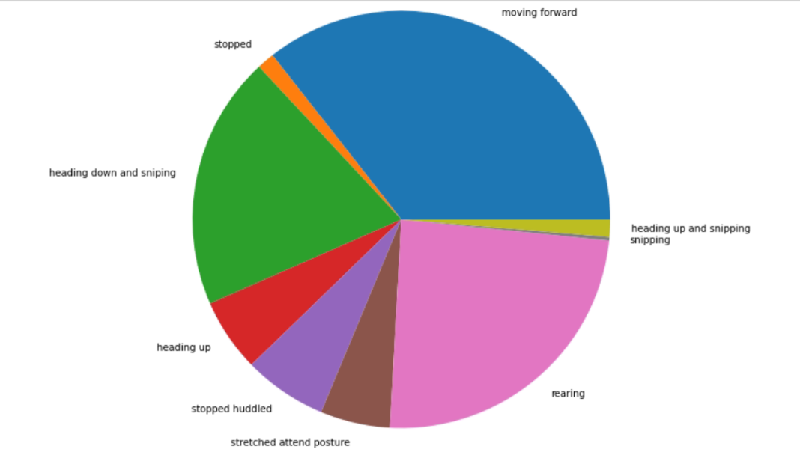
Chap4
Implementation
AI Model: Visualization
Visualization Tool: Library from seaborn and matplotlib
B-fact · 24

Slide 25
Chap5
Testing
Unit test
Front-end
Back-end
AI Model
Temporally make DB array
MySQL test, use templete
Training process
* Import DB Layer
* Django’s own User
Check accuracy
& f1 score
B-fact · 25

Slide 26
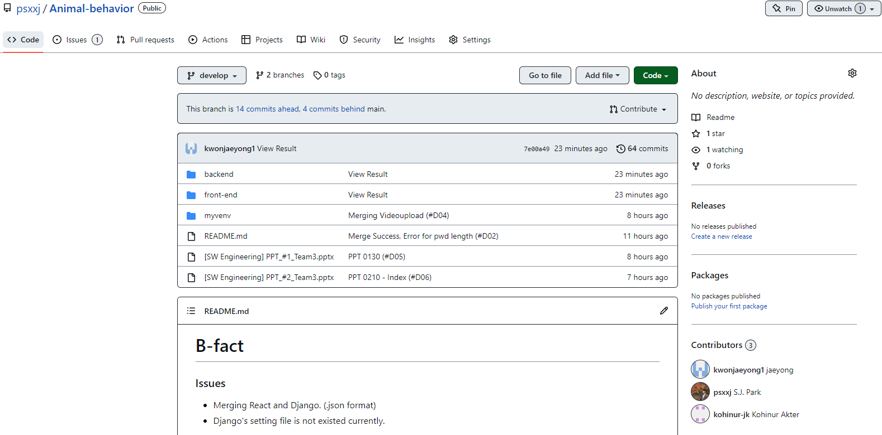



Chap6
Maintenance
VCS & Cooperation Tool
github.com/psxxj/Animal-behavior/
B-fact · 26

Slide 27

Chap7
Q&A
Subtitle
B-fact · 27

